Slide 1
Estimation and Central Limit Theorem
Unit 4

Slide 2
Parameter v/s Statistics
Parameters describe the characteristics of a population, while statistics describe the characteristics of samples. Statistics can be used to estimate parameters, but remember that statistics are only estimates.
What is the Difference Between Parameters and Statistics?
 | Parameter | Statistics
Definition | A numerical characteristic that describes an entire population. | A numerical measure calculated from a sample drawn from the population.
Nature | Fixed and constant | Variable and can change from sample to sample
Value | Unknown (as it pertains to the entire population) | Known (as it is derived from the sample data)
Representation | Represents the entire population | Represents a sample of the population
Usage | Used in theoretical concepts and hypothesis formulation | Used in practical data analysis and research

Slide 3
Parameter v/s Statistics
Accuracy | More accurate as it represents the entire population | It may vary in accuracy as it depends on the sample size and selection
Calculation | It cannot be calculated exactly in most real-world scenarios | Can be calculated using sample data
Purpose | To describe the characteristics of the population | To estimate the population parameters based on sample data
Example | The actual average height of all adults in a country | The average height calculated from a sample group of adults in a country

Slide 4
Central limit theorem for mean
In simple terms, central limit theorem states that for a large sample drawn from a population with mean μ and standard deviation σ, the sampling distribution of mean, x̅, follows an approximate normal distribution with mean μ and standard deviation (standard error) σ / n irrespective of the distribution of the population.
This will hold true regardless of whether the source population is normal or skewed, provided the sample size is sufficiently large (usually n > 30).
If the population is normal, then the theorem holds true even for samples smaller than 30.

Slide 5
Central Limit Theorem
Similarly, if you find the average of all of the standard deviations in your sample, you’ll find the actual standard deviation for your population.
It’s a pretty useful phenomenon that can help accurately predict characteristics of a population.
The picture below shows one of the simplest types of test: rolling a fair die. The more times you roll the die, the more likely the shape of the distribution of the means tends to look like a normal distribution graph. of the population distribution.

Slide 6
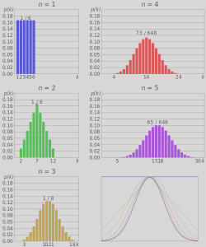
Distribution of graph for rolling a die n times
(n = 1 to 5)

Slide 7
Central Limit theorem
The CLT can be applied to almost all types of probability distributions. But there are some exceptions. For
example, if the population has a finite variance. Also, this theorem applies to independent, identically
distributed variables. It can also be used to answer the question of how big a sample you want. Remember
that as the sample size grows, the standard deviation of the sample average falls because it is the
population standard deviation divided by the square root of the sample size. This theorem is an important
topic in statistics. In many real-time applications, a certain random variable of interest is a sum of a large
number of independent random variables. In such situations, we can use the CLT to justify using the
normal distribution.

Slide 8
Assumptions in Central Limit theorem
The variables present in the sample must follow a random distribution.
The sample variables drawn from a population must be independent of one another.
The sample drawn from the population must be 10% of the population data and it should follow a normal distribution
The size of the sample should be large (>=30) when the population data is either skewed or non-symmetric.
In the case of symmetric data where the population data is near to normal, the size of the sample can be considered small.
As the sample size increases the standard deviation decreases.

Slide 9
Central limit theorem for proportions
If X1, X2, …, Xn are counts from a Bernoulli trials with probability of success p, E(Xi) = p and Var(Xi)= p × (1 − p), then the sampling distribution of probability of success (say p∧) follows an approximate normal distribution with mean p and standard error √p(1− p) /n, where n is the sample size.
The variable (p∧- p)/√p(1-p)/n converges to a standard normal distribution.

Slide 10
Estimation in Statistics
In statistics, estimation refers to the process by which one makes inferences about a population, based on information obtained from a sample.
Purpose of Estimation in Statistics
Statistical estimation is essential for making inferences about populations using sample data, helping to determine parameters like mean and variance without individual measurements.
This evaluation is vital for decision-making in business and healthcare, informing strategies and treatment options.
It is closely linked to hypothesis testing, contributing to scientific development, political decisions, public health, and economic choices.
Risk assessment benefits from evaluation in managing probabilities and risk in finance and insurance.
Quality control also relies on evaluation to ensure products and services meet standards by identifying and correcting deviations.
Estimation is of two types that includes:
Point Estimation
Interval Estimation

Slide 11
Point Estimation
In statistics, the sample mean is used to estimate a population mean, while the sample proportion is used to estimate a population percentage. These measurements help approximate unknown population parameters accurately.
Identifying a single number to represent a large group is like a point estimate. For instance, measuring the heights of random people can be used to estimate the average height of the entire group.
If individuals measured were 5 feet, 6 feet, and 5 feet.
We could estimate the average height to be around 5 feet. This single number, called a score estimator, gives a rough idea of the group's characteristics.
Population mean is estimated using the sample mean.
Similar techniques can be applied to estimate other attributes like percentages of specific characteristics in a population.

Slide 12
Point Estimation Example
Problem 1: Point Estimation (Mean)
A random sample of 10 students from a college class scored the following marks in an exam: 85, 78, 92, 80, 65, 90, 72, 88, 95, 83. Estimate the average score for the entire class.
Solution:
We can use the sample mean (average) as a point estimate for the population mean.
Sample Mean (x̄) = Σ(xi) / n
n is the sample size (n = 10)
Calculating the sum of scores: Σ(xi)= 833
Therefore, Sample Mean (x̄) = 833 / 10 = 83.3

Slide 13
Point Estimation Example
Problem 2: Point Estimation (Proportion)
A survey of 200 customers at a grocery store revealed that 120 prefer brand A. Estimate the proportion of all customers who prefer brand A.
Solution:
We can use the sample proportion (p̂) as a point estimate for the population proportion (p).
Sample Proportion (p̂) = x / n
Therefore, Sample Proportion (p̂) = 120 / 200 = 0.6
Interpretation: Based on the survey, we can estimate that around 60% of all customers at the store prefer brand A.

Slide 14
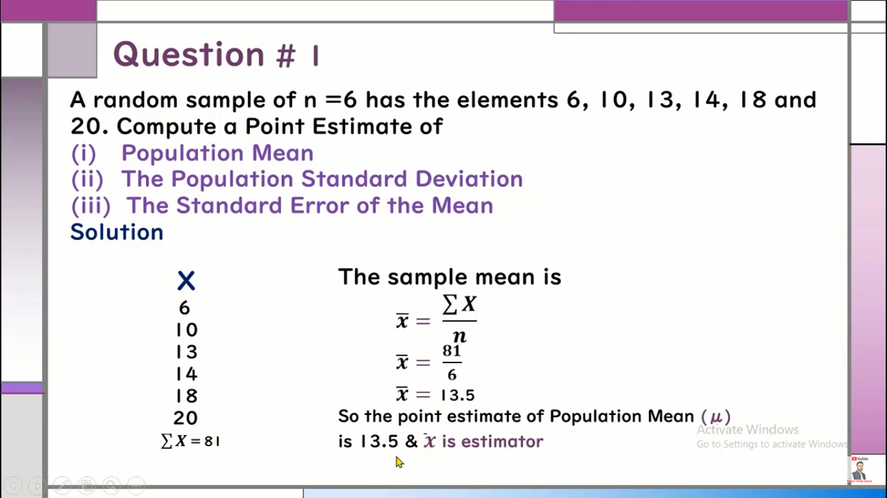
Point Estimation Example

Slide 15
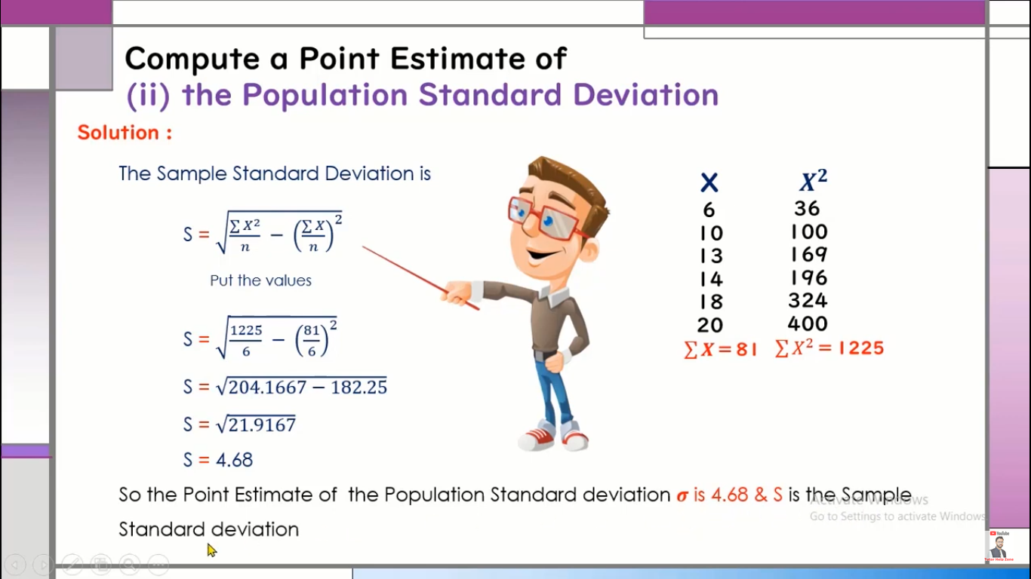
Point Estimation Example

Slide 16
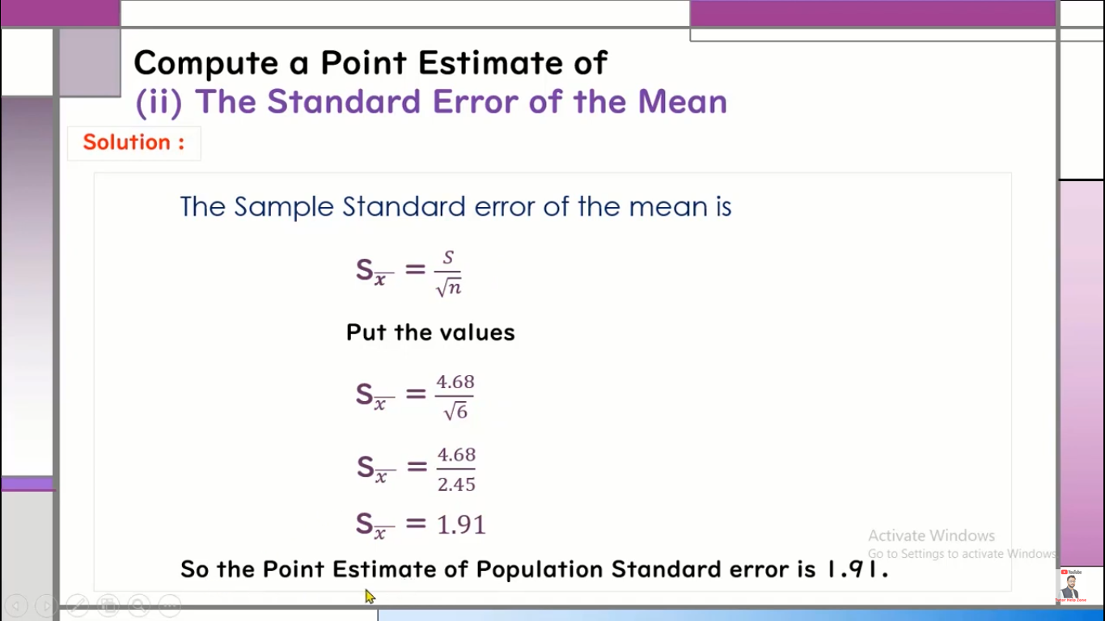
Point Estimation Example

Slide 17
Interval Estimation
An interval estimate is defined by two numbers, between which a population parameter is said to lie. For example, a < x < b is an interval estimate of the population mean μ. It indicates that the population mean is greater than a but less than b.
An interval estimate is a range of values, derived from sample data, that is used to estimate an unknown population parameter. Unlike a point estimate, which gives a single value, an interval estimate provides a range within which the true value of the parameter is likely to fall, offering a degree of uncertainty.
The most common type of interval estimate is a confidence interval, which specifies a range around the point estimate and includes a confidence level (typically 90%, 95%, or 99%). This confidence level represents the probability that the interval contains the true population parameter.
For example:
If we calculate a 95% confidence interval for the population mean, it means that if we were to take many samples and calculate confidence intervals for each, 95% of those intervals would contain the true population mean.

Slide 18
Confidence Intervals
Confidence Intervals as Interval Estimates
confidence interval is a specific type of the interval estimate that provides the range of values for the population parameter with an associated confidence level.
For example : a 95% confidence interval suggests that if we were to take 100 different samples and compute a confidence interval for the each about 95 of them would contain the true population parameter.

Slide 19
Graphical Demonstration of the Confidence Interval for μ
Confidence level
1 - α
Lower confidence limit
Upper confidence limit

Slide 20
The Confidence Interval for μ ( σ is known)
Example: Suppose that σ = 1.71 and n=100. Use a 90%
confidence level.
Solution: The confidence interval is

Slide 21
The Confidence Interval for μ ( σ is known)
Recalculate the confidence interval for 95% confidence level.
Solution:
.95
.90

Slide 22
The Confidence Interval for μ ( σ is known)
The width of the 90% confidence interval = 2(.28) = .56
The width of the 95% confidence interval = 2(.34) = .68
Because the 95% confidence interval is wider, it is
more likely to include the value of μ.
With 95% confidence interval, we allow ourselves to
make 5% error; with 90% CI, we allow for 10%.

Slide 23
Problem 3: Interval Estimation (Confidence Interval for Mean)
Continuing from Problem 1, suppose we want to estimate the average score for the entire class with a 95% confidence level.
Solution:
When a 95% confidence level with 9 degrees of freedom is used, the t-critical value (t*) must be calculated in order to express a mean value using a confidence interval.
Statistical software or internet tables can be used to find T*.
Assuming t* = 2.262 (for a 95% CI with 9 degrees of freedom), we can calculate the margin of error (ME):
ME = (t*) × (standard deviation / √n)
Since we don't have the population standard deviation, we can estimate it using the sample standard deviation (s). You'll need to calculate the sample standard deviation for the scores (around 5.8).
Example Calculation (assuming s = 5.8):
ME = (2.262) × (5.8 / √10) ≈ 4.3
Now, we can construct the confidence interval:
CI = Sample Mean (x̄) ± ME
CI = 83.3 ± 4.3
Therefore, the 95% confidence interval for the mean score is approximately (79, 87.6).
Interpretation: We can be 95% confident that the true average score for the entire class lies somewhere between 79 and 87.6.

